Slide 1

Breast Cancer Detection
Using K-Nearest Neighbor Algorithm

Slide 2
1-Introduction:
Breast cancer is one of the most common types of cancer to occur in women in the world and it affects a significant percentage of women. Even after the huge development in the diagnosis field and the appearance of new technologies it’s still so hard to accurately diagnose the cancer and even harder to determine whether it’s a benign or a malignant cancer. So Even after the huge development in the diagnosis field and the appearance of new technologies it’s still so hard to accurately diagnose the cancer and even harder to determine whether it’s a benign or a malignant cancer.

Slide 3
2-Experiment Environment:
Python is used for implementing this algorithm.

Slide 4
3-Breast Cancer dataset:
A dataset named Wisconsin obtained from the University of Wisconsin.
compromises of 569 instances which 212 cases are malignant, and 357 cases are benign.
The Features of this dataset are computed from a digitized image of a fine needle which describes characteristic of the cell nuclei present in the image.

Slide 5
Ten real-valued features are figured for every cell core:
1. Radius 2. Texture
3. Perimeter(the sum of the distances between consecutive boundary points)
4. Area 5. Smoothness
6. Compactness 7. Concavity
8. Concave points 9. Symmetry
10. Fractal dimension

Slide 6
4-K-Nearest Neighbor (K-NN):
Here objects are classified by the majority of its neighbors.
K-value determines the number of neighbors to be considered for classification.

Slide 7
How it Works :
Read
Read k-value and distance metric and test data.
Calculate
Calculate distance between each training sample and test data.
Sort
Sort distance and determine the majority of category of KNN.
Set
set the majority as the category of test sample.

Slide 8
5-Normalization Techniques:
It is considered as a preprocessing stage which is a scaling technique used to transform all the features of a dataset into an equal wight.

Slide 9
6-Distance Metrics:
Used for majoring the distance between each point and its nearby points.
Selecting better distance function plays a crucial role in improving the performance of our algorithm.

Slide 10
7-Block Diagram:
We started with the preprocessing of the data using the normalization technique which are : Min-Max, Z score and Decimal scaling normalization
After that, we start calculating the distance between the test sample and the training instances using Euclidean, Manhattan, Chebyshev and Cosine.
Then we start comparing the result of each sequence of these preprocessing techniques to find out which one is the most accurate one of them

Slide 11
8-Collective Summarization of obtained results:
NORMALIZATION TECHNIQUE | EUCLIDEAN DISTANCE | MANHATTAN DISTANCE | CHEBYSHEV DISTANCE | COSINE DISTANCE
MIN-MAX | 95.6140, K=8 | 94.7368, K=4 | 98.2456, K=14 | 86.8421, K=14
Z-SCORE | 95.6140, K=4 | 95.6140, K=6 | 98.2456, K=14 | 94.7368, K=4
DECIMAL SCALING | 94.7368, K=4 | 98.2456, K=14 | 48.2456, K=4 | 68.4211, K=10

Slide 12
9-Experiamental results:
After performing the K-Nearest Neighbor algorithm using the different normalization techniques and different distance metrics, The accuracy percentage of each of the 12 combinations was noted in the preview table
We can conclude that the most accurate method of implementing the K-Nearest Neighbor Algorithm for diagnosing Breast Cancer is by using Decimal Scaling normalization technique, Manhattan Distance Function with K value equal to 14.
By using this combination, we have reached an accuracy percentage of 98.2456%

Slide 13
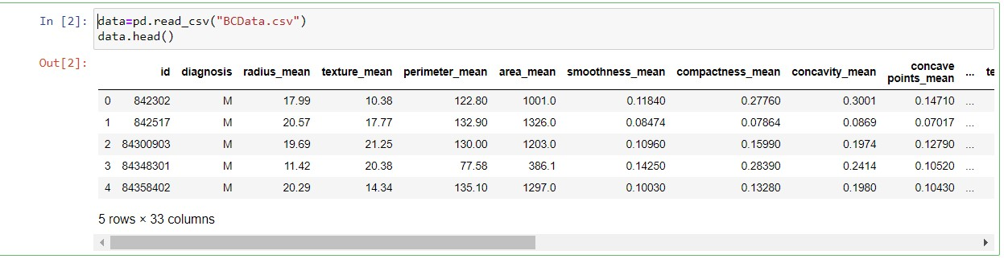
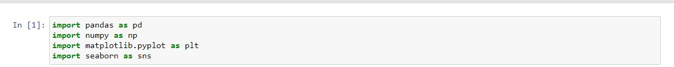
-Imported libraries & -data set

Slide 14
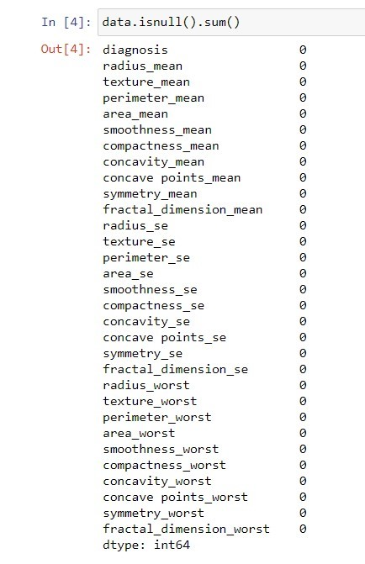
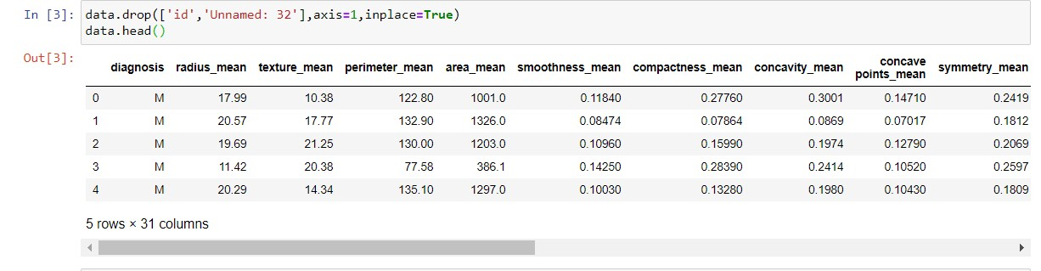
Drop column id & unnamed:32 Checking if ‘Null’ values are exists

Slide 15
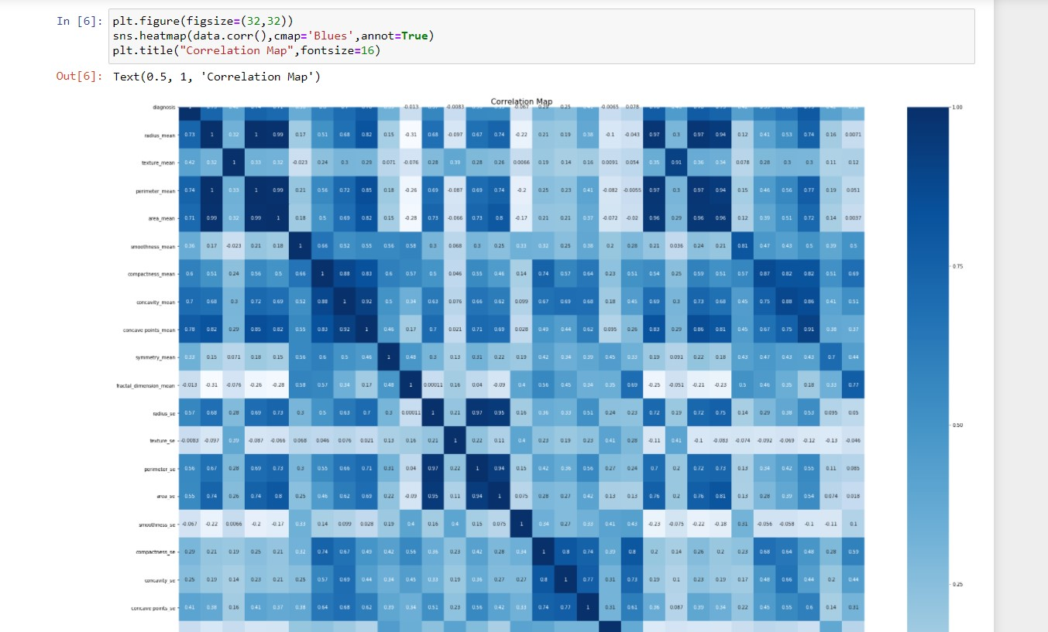
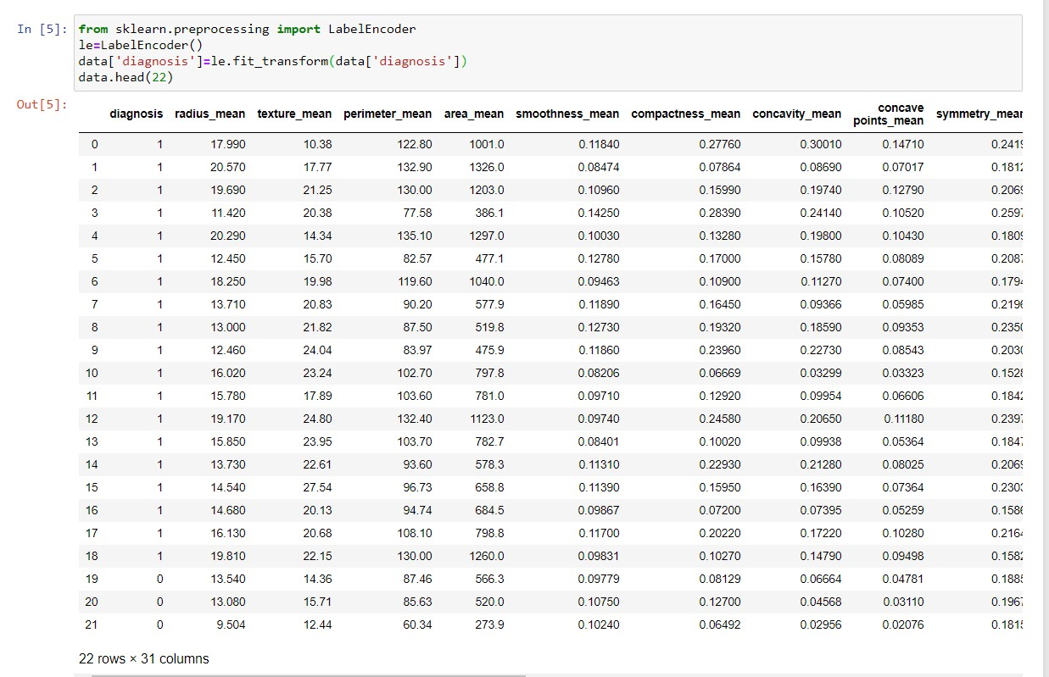
Encoder for label(column) : diagnosis Plotting correlation map

Slide 16
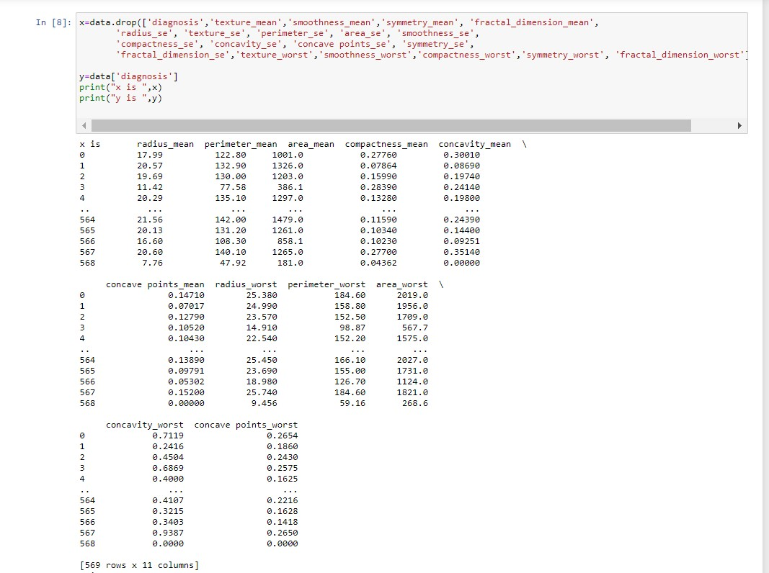
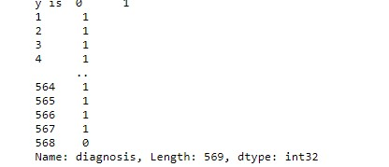
Splitting all data to x and y

Slide 17
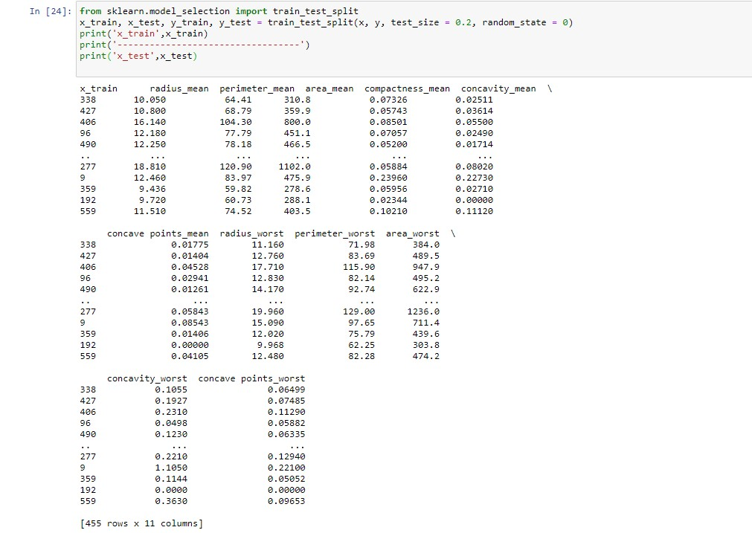
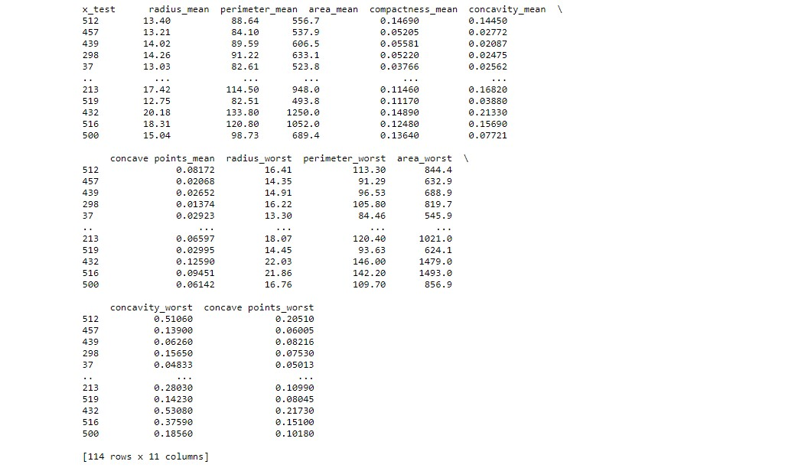
-Train and Test

Slide 18
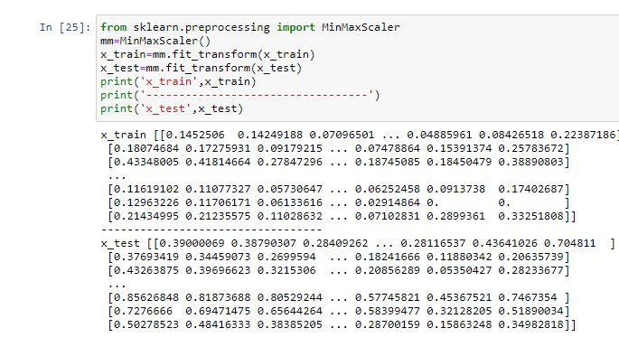
Scaling Values

Slide 19
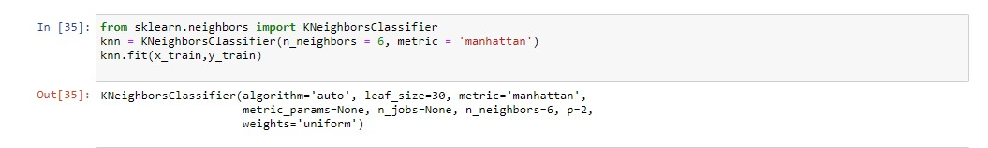
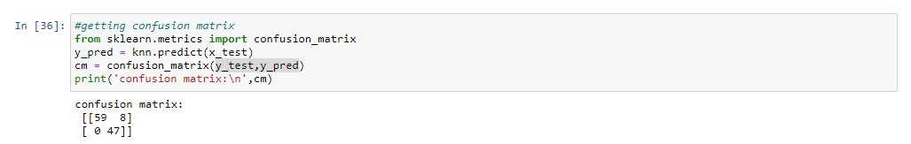
-K-neighbors Classifier using Manhattan -Making Confusion Matrix

Slide 20
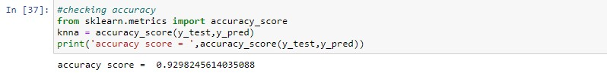
Checking Accuracy

Slide 21
Thanks..

